Slide 1

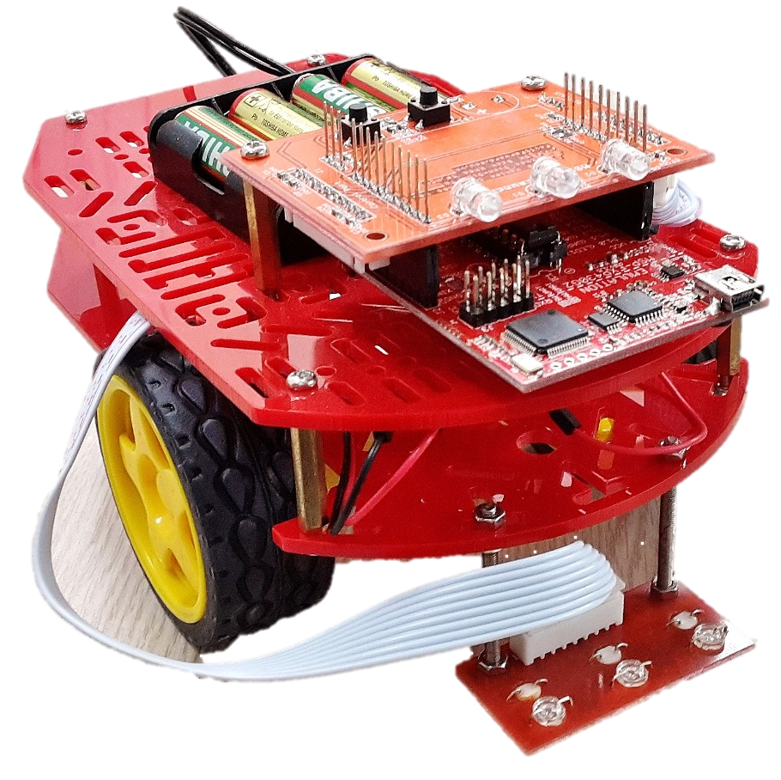

iBot Hardware Description
Ho Chi Minh City University of Technology
Faculty of Electrical and Electronics Engineering
Designed by FEEE Student Research Club - PayItForward

Slide 2
Overview
iBot
Power
Circuit
Sensors
RF Wireless
Data
Transmis-sion
Main
Controller
Circuit
Mechanical
Frame
(*) developed in 2015

Slide 3
1) Main Controller Circuit
Micro-
controller
MSP430G2553 (16-bit)
LED Display
2 status-indicating LEDs (blue – programmable)
Buzzer
1 speaker (programm-able)
1 power-on LED (yellow)
Buttons
Signal Bus
2 buttons (programm-able)
Connecting between power circuit and sensors circuit.

Slide 4
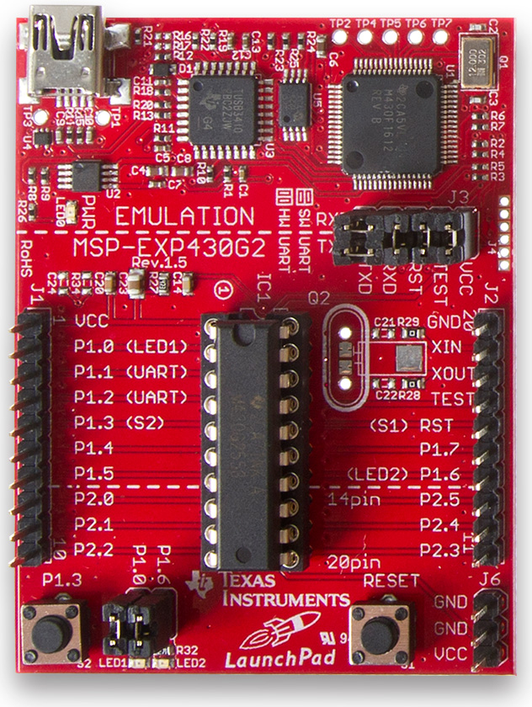
1) Main Controller Circuit
a) Connection diagram between signal pins from Launchpad Kit to other system modules.
iBot uses MSP430 Launchpad Kit from Texas Instruments (TI), with 16-bit microcontroller (MCU) MSP430G2553
b) KIT MSP430 launchpad

Slide 5
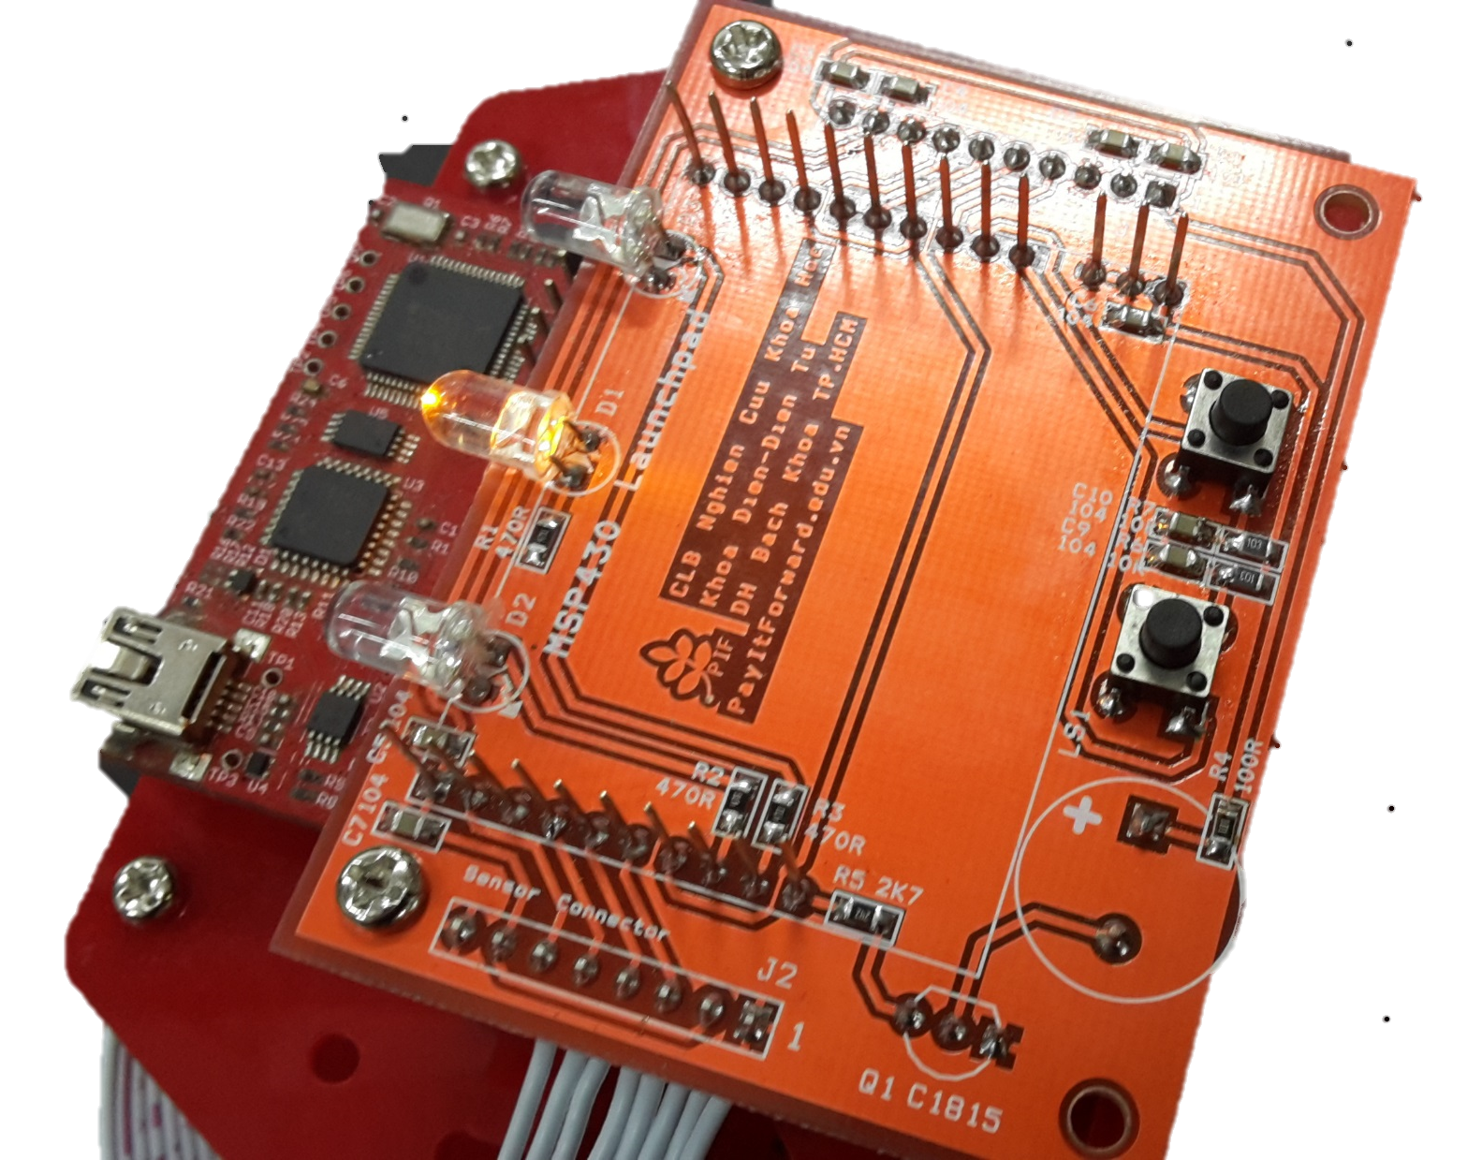
1) Main Controller Circuit
Power-on LED
Indicator LED 1
Indicator LED 2
Indicating Speaker (Buzzer) soldered at back side.
a) LED and Buzzer digram
Student can program to control Indicator LED and Buzzer.

Slide 6
1) Main Controller Circuit
Button 1
Button 2
Buttons circuit diagram
Student can use button 1 & 2 to finish tasks.
Example: Press button 1 to run the robot, button 2 to stop

Slide 7
1) Main Controller Circuit
Connector circuit diagram between power circuit (left, 10-wire bus) and line detection sensor (right – 8-wire bus)/

Slide 8
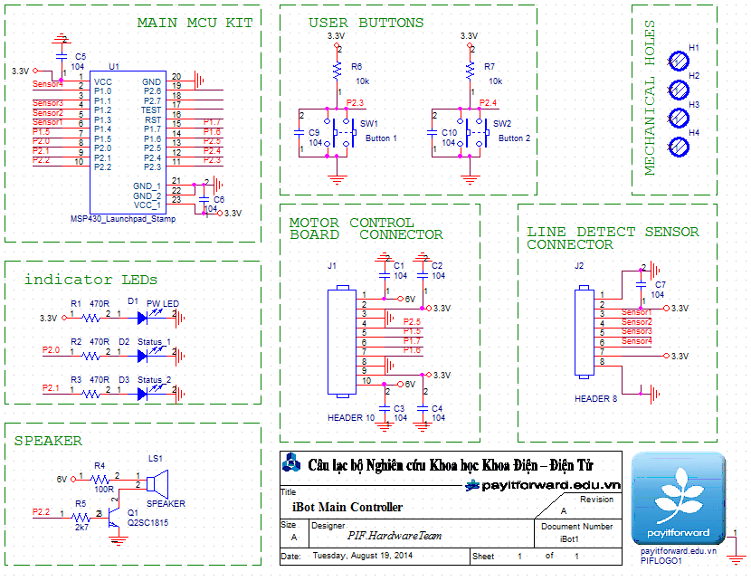
Mạch điều khiển chính
Complete Main Controller Circuit

Slide 9
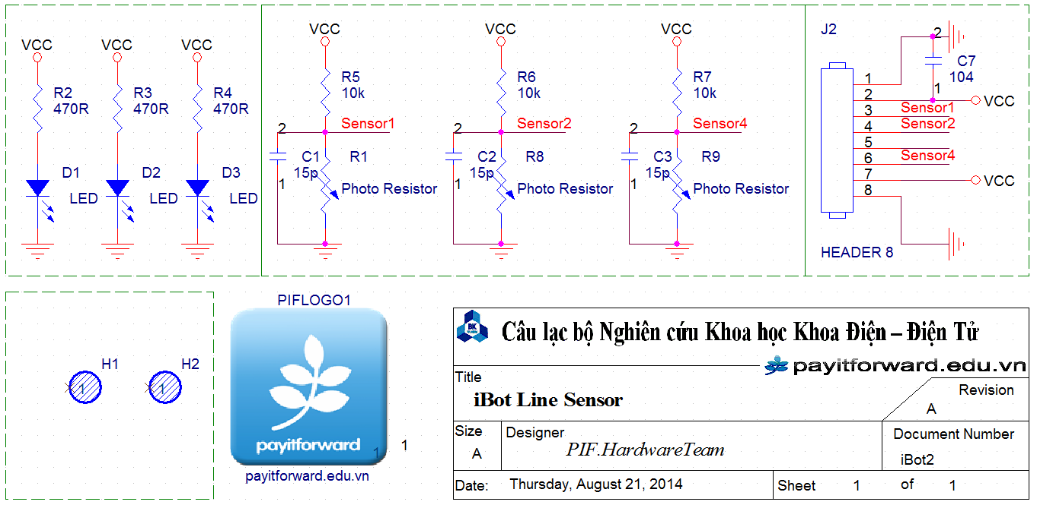
2) Line Detection Sensor Circuit

Slide 10
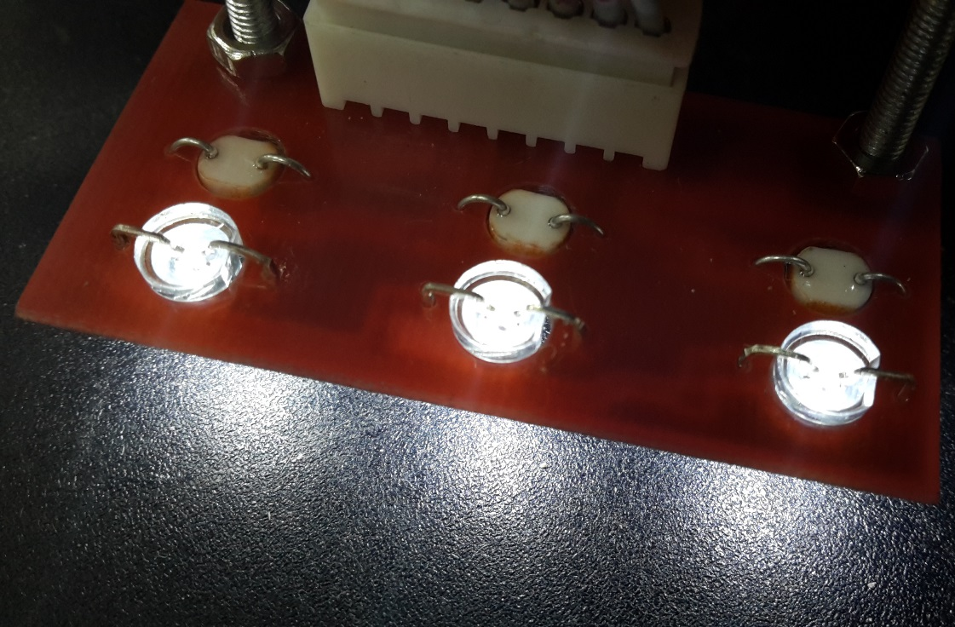
2) Line Detection Sensor Circuit
Line detection circuit (line follower) consists of 3 pairs of LED – photoresistor (LDR)
Working principle
(updating)
Line Detection (line follower) Circuit

Slide 11
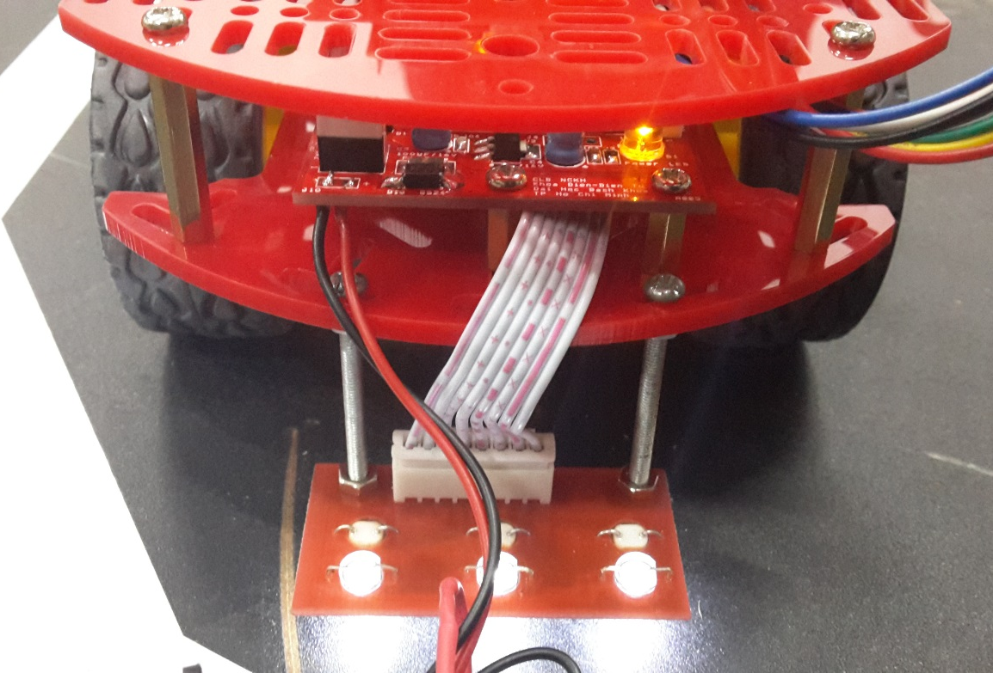
2) Line Detection Sensor Circuit
Line detection circuit (path tracking) consists of 3 pairs of LED – photoresistor (LDR)
Line follower circuit connects with main control circuit by one 8-wire bus.

Slide 12
3) Power Circuit: controlling DC motors
H-bridge circuit working principle:

Slide 13
3) Power Circuit: controlling DC motors
Main IC controlling the power circuit is the MSP430G2553

Slide 14
3) Power Circuit: controlling DC motors
Connecting bus to main controller (MCU MSP430G2553 on top plate)
Level-shifting buffer circuit for signals from MCU to power components

Slide 15
3) Power Circuit: controlling DC motors
H-Bridge circuit controls one motor (2 circuits for 2 motors)

Slide 16
3) Power Circuit: controlling DC motors
a) Voltage measuring circuit
b) Load current measuring circuit
c) Power circuit: 6VDC input from batteries, converting to 3v3 for MCU

Slide 17
3) Power Circuit: controlling DC motors
Over-current protection circuit (checking signal from current measurement circuit)

Slide 18
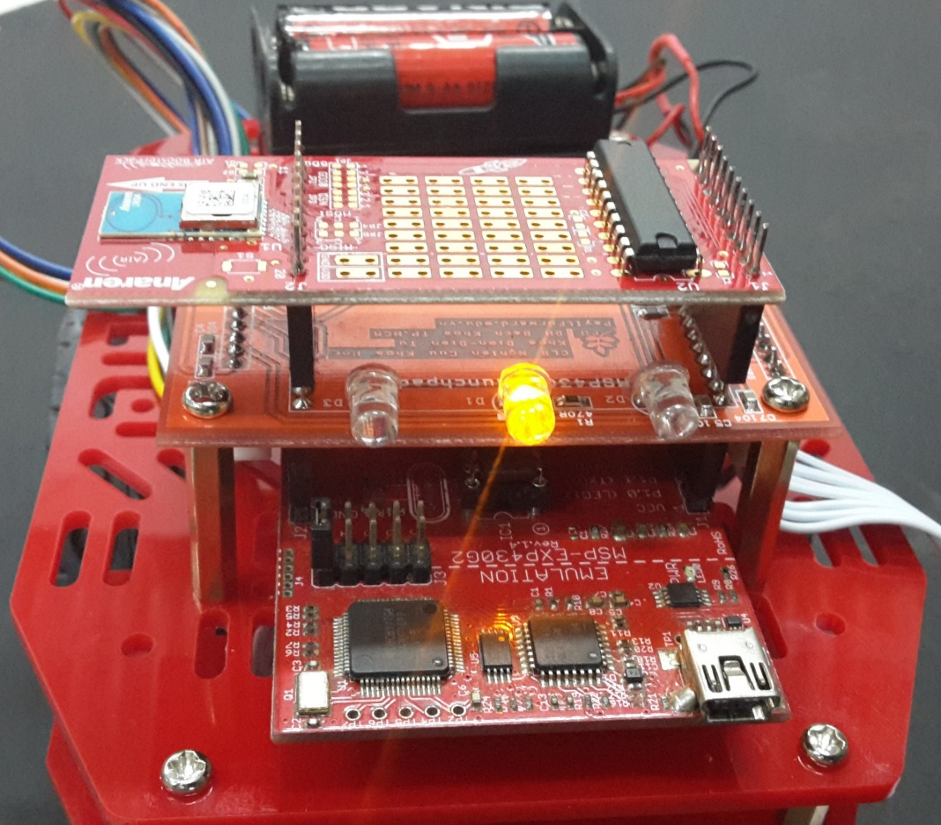
4) Module CC110L RF BoosterPack
Texas Instrument’s RF CC110L Module is placed on top, responsible for transmit wireless data through RF signal.
To be developed in 2015.

Slide 19
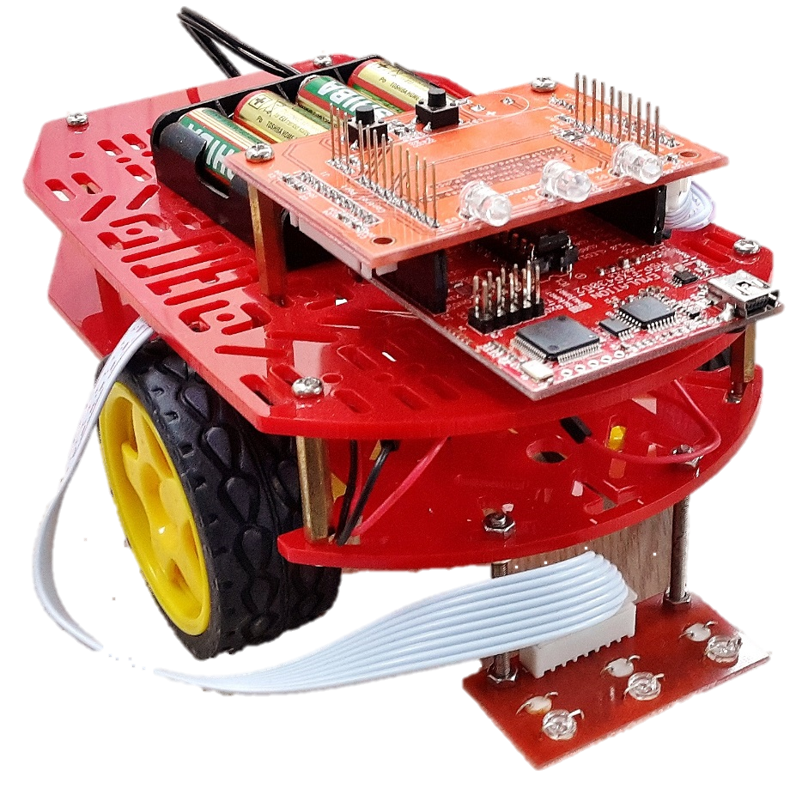
5) Robot Chassis
The robot chassis to be used is Magician Chassic from SparkFun Electronics (US).
Link: https://www.sparkfun.com/products/10825
Measurement: 110 x 174mm
Technical specifications:
Maximum voltage for motor: 6VDC
No-load speed: 90±10rpm
No-load current: 190mA (max.250mA)
Torque: 800gf.cm
Stall Current: ~1A
Wheel diameter: 65mm (30mm Wide)

Slide 20
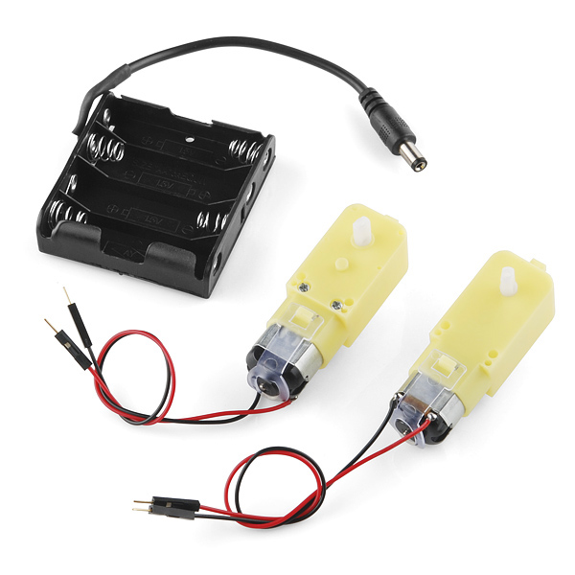
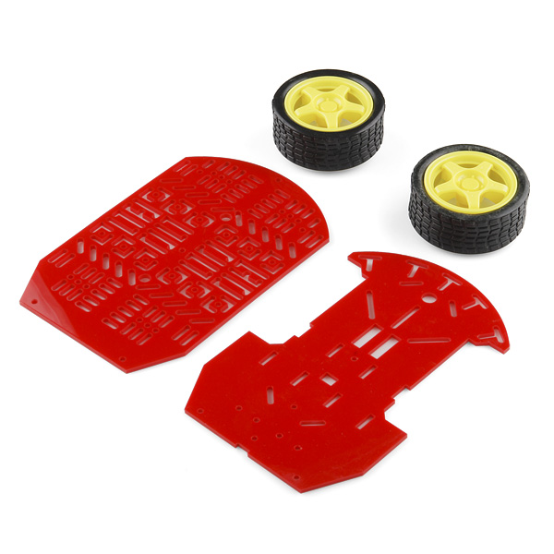
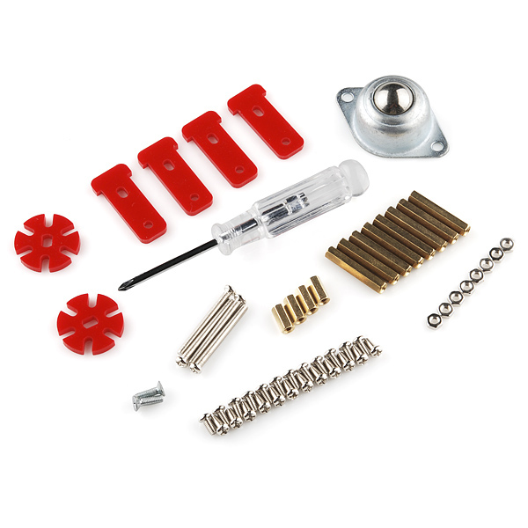
5) Robot Chassis
Magician Chassis Kit’s components: 2 DC Motor + Wheels + Encoder, omni wheel, 4 AA batteries package, acrylic plates and general mechanical items .

Slide 21
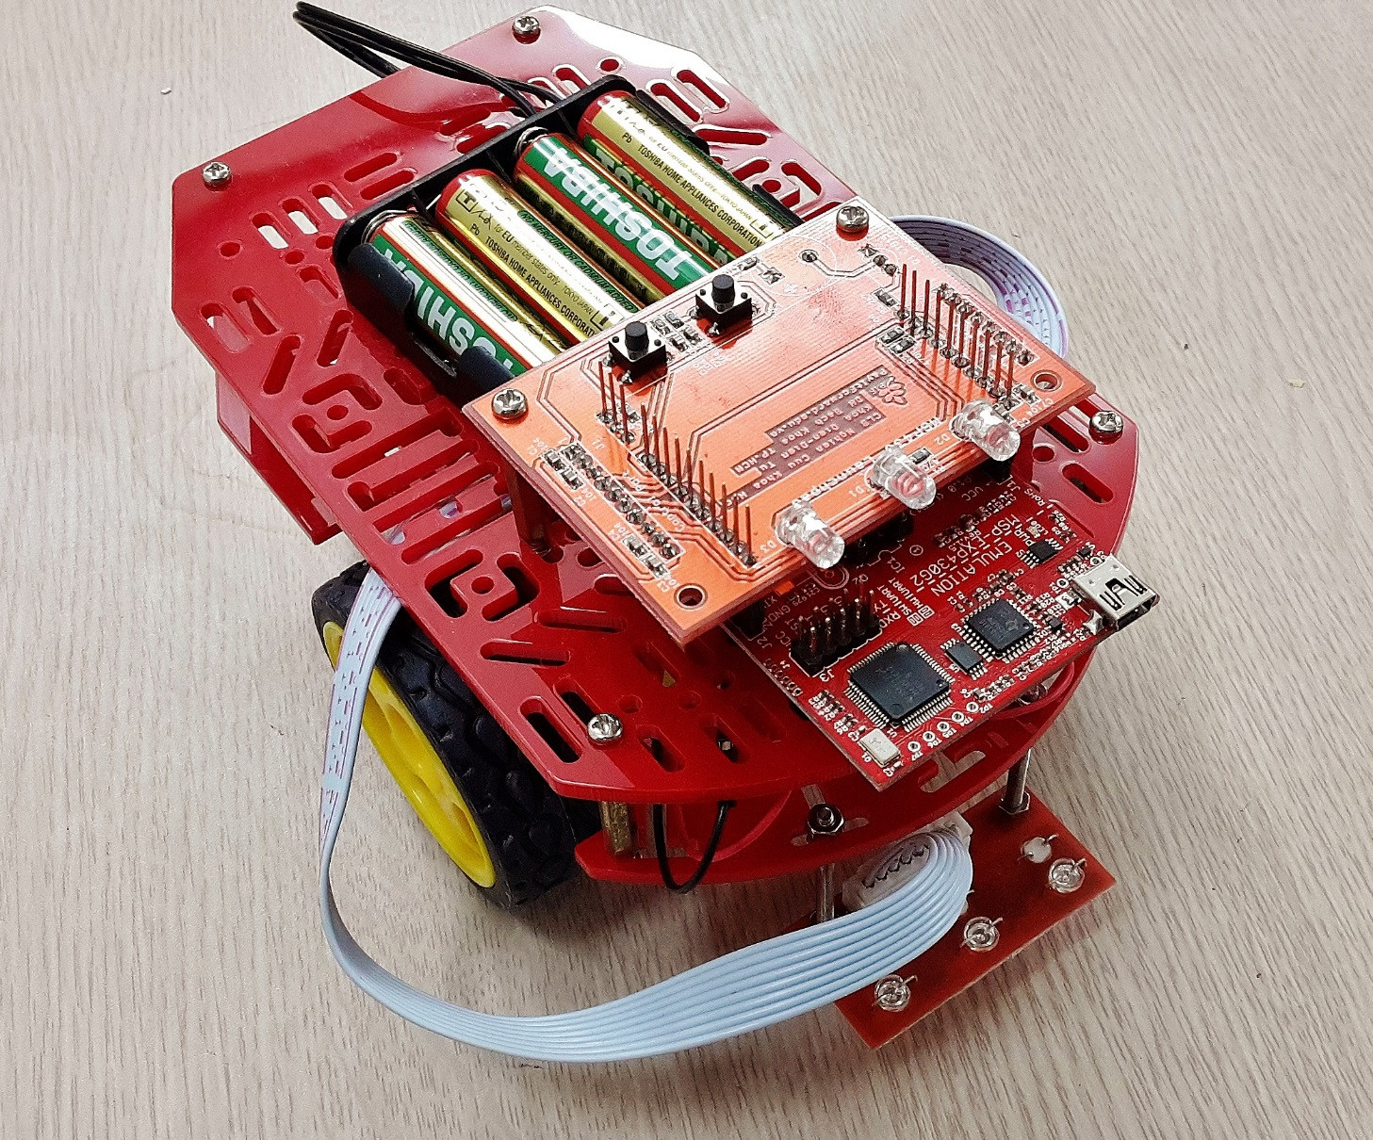
6) Robot Assembled!

